Slide 1



splash1
What is ADDIE?
An Instructional Design framework
Used to develop training or eLearning modules
ADDIE is an acronym for…
THIS COURSE TAKES ABOUT 12 MINUTES TO COMPLETE

Slide 2

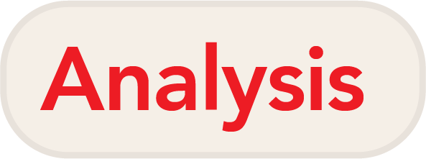






splash2
The name is an acronym for the five phases of design and development, which include Analysis, Design, Development, Implementation and Evaluation. The phases generally take place in sequence, with Design following Analysis, and so on.
The exception is the Evaluation step, which is done at the end, but aspects of evaluation take place throughout the process. The process is circular in that after evaluation, the course may be tweaked or redesigned and the cycle repeats again.
Notes:
The name is an acronym for the five phases of design and development, which include:
Analysis, Design, Development, Implementation and Evaluation.
The phases generally take place in sequence, with Design following Analysis, and so on.
The exception is the Evaluation step, which is done at the end, but aspects of evaluation take place throughout the process.
The process is circular in that after evaluation, the course may be tweaked or redesigned and the cycle repeats again.

Slide 3





1-1
It’s a really smart idea to begin with an analysis phase. Gathering relevant information and context beforehand will help you to develop the most effective material.
Needs analysis. What is the goal of the training? What outcome do you want to produce? The emphasis here is more about the outcome, rather than the individual learner.
Analysis
Needs analysis
Instructional analysis
Audience analysis
Context analysis
Instructional analysis. Break down the steps needed to produce the outcome. What specific topics or concepts will your instruction need to cover in order to support the goal?
Audience analysis. Who is your audience? What prior knowledge do they have? Do they have limitations? What is their motivation for completing your course?
Context Analysis. Are the learners students in a classroom, or taking training on their own? Is it something for work, or school? Context matters when you are making decisions about what will work best for your course.
Notes:
It’s a really smart idea to begin with an analysis phase.
Gathering relevant information and context beforehand will help you to develop the most effective material.
Needs analysis. What is the goal of the training?
What outcome do you want to produce?
The emphasis here is more about the outcome, rather than the individual learner.
Instructional analysis. Break down the steps needed to produce the outcome.
What specific topics or concepts will your instruction need to cover in order to support the goal?
Audience analysis. Who is your audience? What prior knowledge do they have?
Do they have limitations? What is their motivation for completing your course?
Context Analysis. Are the learners students in a classroom, or taking training on their own?
Is it something for work, or school?
Context matters when you are making decisions about what will work best for your course.

Slide 4
1-2
The other thing you need to nail down in the Analysis phase is your Learning Objective or objectives. Once you have a clear objective defined, you can refer back to it and make sure that all the content and activities point back to that objective.
Learning Objectives should be…
Specific
Well-defined
Measurable
It’s a really smart idea to begin with an analysis phase. Gathering relevant information and context beforehand will help you to develop the most effective material.
Notes:
The other thing you need to nail down in the Analysis phase is your Learning Objective or objectives.
Once you have a clear objective defined, you can refer back to it and make sure that all the content and activities point back to that objective.
When writing a learning objective, you must make sure that it is specific and measurable.

Slide 5
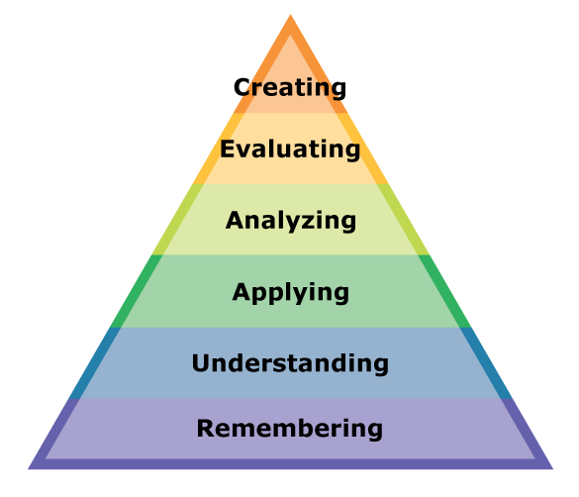
1-3
“After a student completes this course, he or she should be able to _______”
explain...
identify...
produce…
Bloom’s Taxonomy
Notes:
Learning Objectives focus on the learner. “After a student completes this course, he or she should be able to…”
Learning objectives need to be specific. Use precise verbs to describe exactly what skill or understanding the student will have gained.
You can use Bloom’s Taxonomy to guide you here, using words like Demonstrate, Create, Recall, etc.

Slide 6
1-4
Take-away:
With well-defined goals from the start, you will have a standard by which you can judge whether the learning experience is successful.
Notes:
Doing a thorough analysis of your goals and your learners will save you time
and guide your efforts to make a learning experience that is targeted and effective.
With well-defined goals from the start, you will have a standard by which you can judge
whether the learning experience is successful.

Slide 7
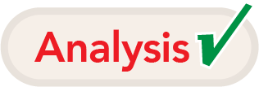

2-1
Design
Complete text for all elements including quizzes
Overall graphic design
All illustrations and infographics
All videos or media
Notes:
The design phase is where all your content, learning activities and assessments are created.
That means all the text should be written and all the graphics or other media
should be created by the end of the Design phase.

Slide 8
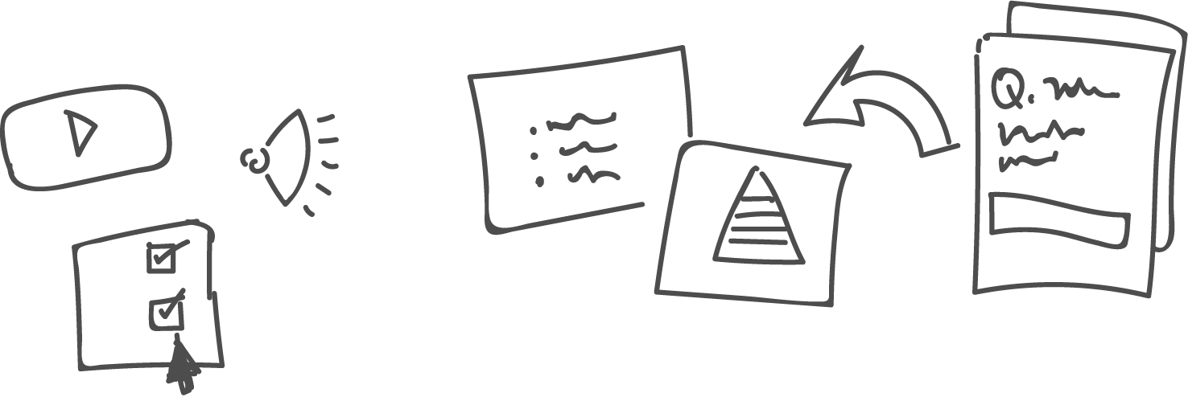
2-2
Design
Presentation
Backwards Course Design
Notes:
Decide how you will present informational content.
An E-Learning course may include text, voice-over, videos, infographics or
interactive activities to present the material.
It can be helpful as you design your course, to begin with the assessment and work your way backwards.
You have learning objectives already, from the Analysis phase.
Write a quiz (or define another way of assessing knowledge or skill)
that will tell you whether your students have met the objective.

Slide 9



2-3
Design
Connect
Absorb
Do
Notes:
Three good ways to present information include “Absorb”, “Connect” and “Do” activities.
“Absorb” is the most passive: watching a slideshow or reading content on the screen
to absorb information.
“Connect” activities ask the learner to connect what they are learning with real-world tasks.
“Do” activities are the most interactive. Learners are given the opportunity to try out the skill or interact with a simulation.

Slide 10
2-4
Deliverable: Storyboards
All the complete and final text
Complete text for quizzes, including correct answers
Finished designs, graphics and media
Clear depiction of your navigation systems
Details about any interactive elements or animations
Developer-ready
Notes:
At the end of the Design phase for an eLearning project, you should have complete storyboards for the entire course. What does this mean?
E-Learning storyboards aren’t quite the same as storyboards for movies or video.
Your storyboards will be used to define and get approval on all aspects of your course.
They must be complete and final, and include all text and design elements.
For e-Learning, the “storyboard” is a set of documents that includes:
All the complete and final text for every screen in the course, whether that text is in a voice-over script, video, or displayed on screen.
Complete text for any quizzes or assessments, including correct answers.
Finished designs, graphics and media for every screen in the course.
Clear depiction of your navigation system (menu, pause and play or next buttons, etc.), and description of how it will work.
Detailed descriptions of any interactive elements or animations that will happen on each screen.
Ideally, a developer should be able to take the storyboard you created, and create the final course from it without any input from you.

Slide 11
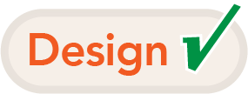

3-1
A few of the currently popular software tools include Adobe Captivate and Articulate Storyline 360. All of the specialized apps will enable you to create courses that learners can interact with and take an assessment or quiz at the conclusion. These tools are also what makes it possible to create complex navigation, voice-overs, animation and interaction.
After your storyboards are approved, it’s time to put it all together into a working course. There are many options for eLearning development. While you could deliver your eLearning as a website, a set of videos or a PowerPoint presentation, there are many specialized applications that make interactive features easier to include.
Development Tools
Videos
PowerPoint
Adobe Captivate
Articulate Storyline 360
Notes:
After your storyboards are approved, it’s time to put it all together into a working course.
There are many options for e-Learning development.
While you could deliver your eLearning as a website, a set of videos or a PowerPoint presentation,
there are many specialized applications that make interactive features easier to include.
A few of the currently popular software tools include Adobe Captivate and Articulate Storyline 360.
All of the specialized apps will enable you to create courses that learners can interact with
and take an assessment or quiz at the conclusion.
These tools are also what makes it possible to create complex navigation, voice-overs, animation and interaction.

Slide 12

3-2
Quality Assurance: Making sure it works
Notes:
It’s not done until it passes QA!
QA, or Quality Assurance, is the practice of testing your course
by playing through it multiple times and testing all interactions to make sure there are no errors or glitches.
Just as with proofreading, it is a good idea to have another person QA your work.

Slide 13
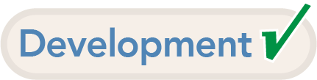

4-1
Implementation
Upload or otherwise deliver the course material
Train instructors
Prepare the classroom or learning environment
LMS = Learning Management System
Notes:
The Implementation phase is when your course is made available to learners and instructors.
What does implementation include? For e-Learning, implementation would include
uploading the course to the LMS (learning management system) or website that hosts it.
Implementation can also include training instructors on the course, and preparing the environment for students.

Slide 14
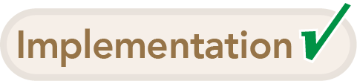

5-1
Evaluation: Formative Assessment
One-on-one Evaluation
Small-group Evaluation
Field Trial
Clarity
Impact
Feasibility
Notes:
The final step in the ADDIE system is to Evaluate your course, and the results.
There are two aspects to this evaluation stage: Formative Assessments and Summative Assessments.
Formative Assessments – while the course is in progress (in other words, during the Formation of your course),
you will perform formative assessments on pieces of your course.
You can do this one-on-one, with a small group evaluation, or as a Field Trial.
Whichever evaluation method you choose, make sure you get reactions on the
Clarity, Impact and Feasibility of the lesson you are evaluating.
For example, were the objectives clear?
What did you learn from the lesson, what impact did it have on you?
Is this lesson practical for the intended audience to undertake?

Slide 15

5-2
Evaluation: Summative Assessment
Reaction
Learning
Behavior
Results
Notes:
Summative Assessments take place after learners have completed your course.
It “sums up” the results, and can include quantitative information.
It proves the worth of the learning experience that you created.
You will want to gauge the Reaction, Learning, Behavior and Results related to your course.
For reactions, you could give students a survey that asks them to rate the course or offer suggestions.
Learning can be gauged by a quiz or interview.
Behavior measures whether the learner uses the new skills they have gained.
Assessment of results is similar, but may entail broader effects that the new behavior makes possible.

Slide 16

Quiz-1
Choose the correct word: The first step in ADDIE is:
Accommodate
Analysis
Assessment
Arrange
Acquisition

Slide 17
Quiz-1-x
X The correct answer is “Analysis.”

Slide 18
Quiz-1-c
X That’s correct!

Slide 19
Quiz-2
Choose the correct word: The second step in ADDIE is:
Develop
Decode
Decision
Design
Delegate

Slide 20
Quiz-2-x
X The correct answer is “Design.”

Slide 21
Quiz-2-c
X That’s correct!

Slide 22
Quiz-3
Choose the correct word: The third step in ADDIE is:
Decision
Development
Decoding
Design
De-escalate

Slide 23
Quiz-3-x
X The correct answer is “Development.”

Slide 24
Quiz-3-c
X That’s correct!

Slide 25
Quiz-4
Choose the correct word: The fourth step in ADDIE is:
Instruction
Institute
Iteration
Inform
Implementation

Slide 26
Quiz-4-x
X The correct answer is “Implementation.”

Slide 27
Quiz-4-c
X That’s correct!

Slide 28
Quiz-5
Choose the correct word: The final step in ADDIE is:
Education
Evaluation
Evolve
Examine
Ergonomic

Slide 29
Quiz-5-x
X The correct answer is “Evaluation.”

Slide 30
Quiz-5-c
X That’s correct!

Slide 31
Quiz-6
Having a colleague play through your finished eLearning course to make sure everything is working properly is an example of:
Summative Assessment
Quality Assurance
Formative Assessment
A “Connect” Activity

Slide 32
Quiz-6-x
X The correct answer is “Quality Assurance.” A Summative Assessment takes place after the course is completed, and evaluates course success. A Formative Assessment can take place before the course is finished, but is wider in scope than making sure the mechanics work.

Slide 33
Quiz-6-c
X That’s correct!

Slide 34
Quiz-7
Summative Assessments are part of which step in ADDIE?
Analysis
Design
Development
Implementation
Evaluation

Slide 35
Quiz-7-x
X The correct answer is “Evaluation, ” the final step of ADDIE.

Slide 36
Quiz-7-c
X That’s correct!

Slide 37
Quiz-8
Which one of these items falls into the Analysis phase of ADDIE?
Writing the final Quiz
Loading the course into an LMS
Writing Learning Objectives
Gathering graphic assets

Slide 38
Quiz-8-x
X The correct answer is “Writing learning objectives.”

Slide 39
Quiz-8-c
X That’s correct!

Slide 40
Quiz-9
Which of these tasks is not part of the Design step?
Creating infographics
Writing the voice-over copy
Giving a user survey
Find supporting video content

Slide 41
Quiz-9-x
X The correct answer is “Giving a user survey.” Doing this could be part of your research in the Analysis phase, or gauging your users’ reaction in the Evaluation phase.

Slide 42
Quiz-9-c
X That’s correct!

Slide 43
Quiz-10
True or False: Formative Assessments can be a part of all the phases of ADDIE
True
False

Slide 44
Quiz-10-x
X The correct answer is “True.” You should be evaluating your work throughout the process.

Slide 45
Quiz-10-c
X That’s correct!

Slide 46
final
You have completed the course!
Click to go back to the course material. (You may take the quiz multiple times.)

